Slide 1
Scaling Deep Learning on GPU and Knights Landing Clusters
Xiaotian Dou
University of Pittsburgh

Slide 2
Outline
Introduction
Background
Related Work
Experimental Setup
Distributed Algorithm Design
Algorithm Architecture Design
Result and Discussion

Slide 3
Introduction
Deep Learning Applications require large computing power
Current solutions like GPGPUs or FPGA need to fetch data from either CPU memory or remote processors at runtime, we use multi-GPU platform and Intel Knights Landing cluster(self-host chip) as target platform.
Algorithm side, we improved the Elastic Averaging SGD(EASGD) method by redesigning four efficient distributed algorithms:
Async EASGD -> Async MEASGD -> Hogwild EASGD -> Sync EASGD

Slide 4
Background
Intel Knights Landing Architecture:
Self-hosted Platform: self-hosted by an operating system, no need for CPU
Better Memory: 384 GB
Configurable NUMA: Non-uniform memory access

Slide 5
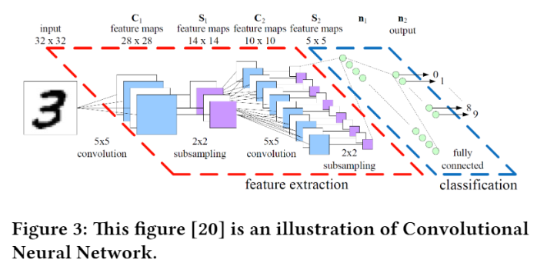
Convolutional Neural Networks

Slide 6

Stochastic Gradient Descent

Slide 7
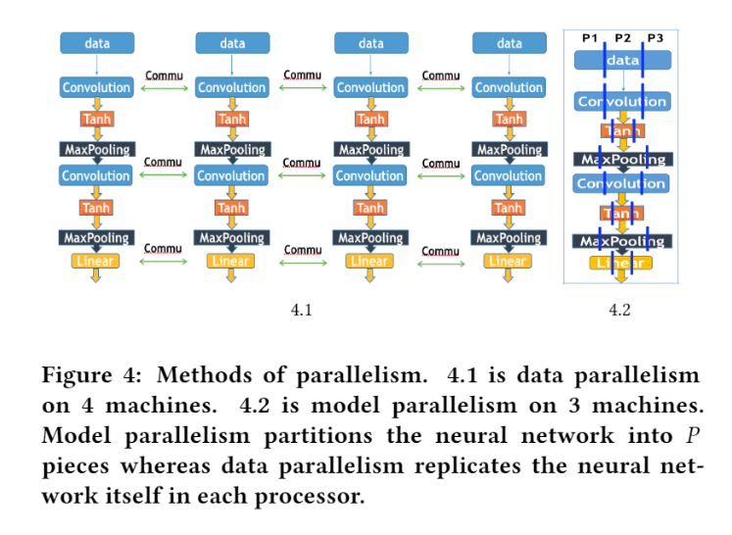
Data Parallelism and Model Parallelism

Slide 8
Related Work
Parameter Server
Hogwild
EASGD

Slide 9
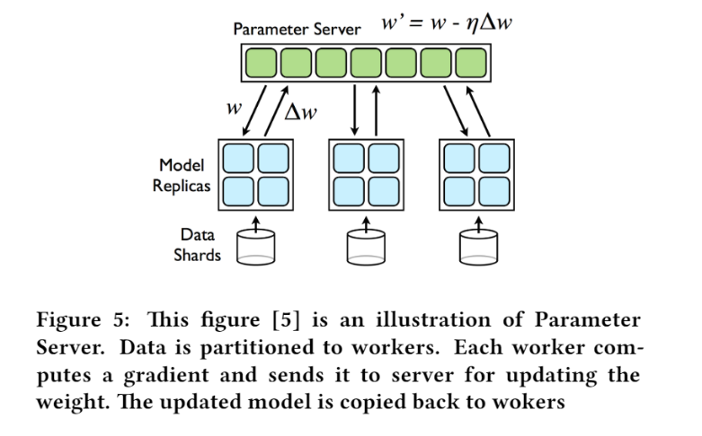
Parameter Server(Async SGD)

Slide 10
Hogwild (Lock Free)
Async SGD has a lock to avoid weight update conflict, make sure the master only processes one sub-gradient at a time.
The hogwild removes the lock and allows the master to process multiple sub-gradients at the same time.

Slide 11
EASGD(Round-Robin)
Round-robin VS FCFS strategy
The master interact with one single worker at a time
Baseline

Slide 12
Distributed Algorithm Design
Redesigning the parallel SGD methods
The computation and update of different GPUs are ordered, good fault-tolerance but inefficient.
To use parameter-server update to replace the round-robin update:
Use FCFS strategy to process multiple workers

